Slide 1
JDBC

Slide 2
What is JDBC?
JDBC stands for Java Database Connectivity, which is a standard Java API for database-independent connectivity between the Java programming language and a wide range of databases.
The JDBC library includes APIs for each of the tasks commonly associated with database usage:
Making a connection to a database
Creating SQL or MySQL statements
Executing that SQL or MySQL queries in the database
Viewing & Modifying the resulting records

Slide 3
JDBC Architecture
general JDBC Architecture consists of two layers:
JDBC API: This provides the application-to-JDBC Manager connection.
JDBC Driver API: This supports the JDBC Manager-to-Driver Connection.

Slide 4
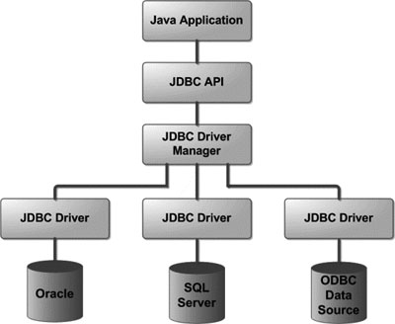

Slide 5
Common JDBC Components
The JDBC API provides the following interfaces and classes:
DriverManager: This class manages a list of database drivers. Matches connection requests from the java application with the proper database driver using communication subprotocol. The first driver that recognizes a certain subprotocol under JDBC will be used to establish a database Connection.
Driver: This interface handles the communications with the database server. You will interact directly with Driver objects very rarely. Instead, you use DriverManager objects, which manages objects of this type. It also abstracts the details associated with working with Driver objects
Connection : This interface with all methods for contacting a database. The connection object represents communication context, i.e., all communication with database is through connection object only.
Statement : You use objects created from this interface to submit the SQL statements to the database.
ResultSet: These objects hold data retrieved from a database after you execute an SQL query using Statement objects. It acts as an iterator to allow you to move through its data.
SQLException: This class handles any errors that occur in a database application.

Slide 6
What is JDBC Driver ?
JDBC drivers implement the defined interfaces in the JDBC API for interacting with your database server.
For example, using JDBC drivers enable you to open database connections and to interact with it by sending SQL or database commands then receiving results with Java.

Slide 7
JDBC Drivers Types
Sun has divided the implementation types into four categories, Types 1, 2, 3, and 4.
Type 1: JDBC-ODBC Bridge Driver
In a Type 1 driver, a JDBC bridge is used to access ODBC drivers installed on each client machine. Using ODBC requires configuring on your system a Data Source Name (DSN) that represents the target database.

Slide 8
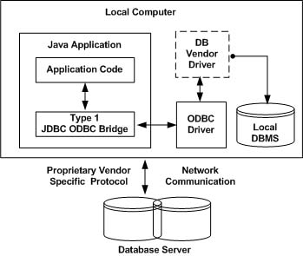

Slide 9
Type 2: JDBC-Native API
In a Type 2 driver, JDBC API calls are converted into native C/C++ API calls.
If we change the Database we have to change the native API.
The Oracle Call Interface (OCI) driver is an example of a Type 2 driver.

Slide 10
Type 3: JDBC-Net pure Java
In a Type 3 driver, a three-tier approach is used to accessing databases.
The JDBC clients use standard network sockets to communicate with an middleware application server.
The socket information is then translated by the middleware application server into the call format required by the DBMS, and forwarded to the database server.
This kind of driver is extremely flexible, since it requires no code installed on the client and a single driver can actually provide access to multiple databases.

Slide 11
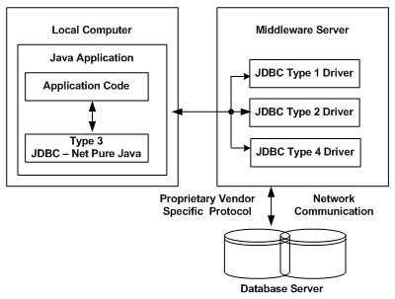

Slide 12
Type 4: 100% pure Java
In a Type 4 driver, a pure Java-based driver that communicates directly with vendor's database through socket connection. This is the highest performance driver available for the database and is usually provided by the vendor itself.
This kind of driver is extremely flexible, you don't need to install special software on the client or server. Further, these drivers can be downloaded dynamically.

Slide 13
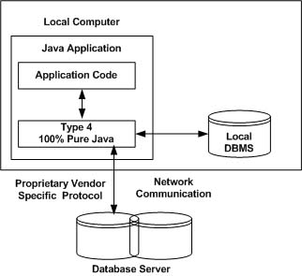
MySQL's Connector/J driver is a Type 4 driver.

Slide 14
Which Driver should be used?
If you are accessing one type of database, such as Oracle, Sybase, or IBM, the preferred driver type is 4.
If your Java application is accessing multiple types of databases at the same time, type 3 is the preferred driver.
Type 2 drivers are useful in situations where a type 3 or type 4 driver is not available yet for your database.
The type 1 driver is not considered a deployment-level driver and is typically used for development and testing purposes only.

Slide 15
JDBC Connection
four steps:
Import JDBC Packages: Add import statements to your Java program to import required classes in your Java code.
Register JDBC Driver: This step causes the JVM to load the desired driver implementation into memory so it can fulfill your JDBC requests.
Database URL Formulation: This is to create a properly formatted address that points to the database to which you wish to connect.
Create Connection Object: Finally, code a call to the DriverManager object's getConnection( )method to establish actual database connection.

Slide 16
Import JDBC Packages
import java.sql.* ; // for standard JDBC programs
Register JDBC Driver
Registering the driver is the process by which the DBMS driver's class file is loaded into memory so it can be utilized as an implementation of the JDBC interfaces.

Slide 17
Register JDBC Driver
You need to do this registration only once in your program. You can register a driver in one of two ways.
1. Class.forName()-
try {
Class.forName("oracle.jdbc.driver.OracleDriver");
}
catch(ClassNotFoundException ex) {
System.out.println("Error: unable to load driver class!");
System.exit(1);
}

Slide 18
2. DriverManager.registerDriver():
try {
Driver myDriver = new oracle.jdbc.driver.OracleDriver();
DriverManager.registerDriver( myDriver );
}
catch(ClassNotFoundException ex) {
System.out.println("Error: unable to load driver class!");
System.exit(1);
}

Slide 19
Database URL Formulation
After you've loaded the driver, you can establish a connection using theDriverManager.getConnection() method.
getConnection(String url)
getConnection(String url, String user, String password)
Following lists down popular JDBC driver names and database URL.
com.mysql.jdbc.Driver jdbc:mysql://hostname/ dbName
oracle.jdbc.driver.OracleDriver jdbc:oracle:thin:@hostname:portNumber:dbName
com.ibm.db2.jdbc.net.DB2Driver jdbc:db2:hostname:port Number/databaseName

Slide 20
Create Connection Object
you have to call getConnection() method with appropriate username and password to get aConnection object as follows:
String URL = "jdbc:oracle:thin:@localhost:1521:EMP";
String USER = "username";
String PASS = "password"
Connection conn = DriverManager.getConnection(URL, USER, PASS);

Slide 21
Closing JDBC connections
At the end of your JDBC program, it is required explicitly close all the connections to the database to end each database session.
However, if you forget, Java's garbage collector will close the connection when it cleans up stale objects.
conn.close();

Slide 22
JDBC - Statements, PreparedStatement
Once a connection is obtained we can interact with the database.
Statement: Use for general-purpose access to your database. Useful when you are using static SQL statements at runtime. The Statement interface cannot accept parameters.
PreparedStatement: Use when you plan to use the SQL statements many times. The PreparedStatement interface accepts input parameters at runtime.

Slide 23
Statement stmt = null;
try {
stmt = conn.createStatement( );
. . .
}
catch (SQLException e) {
. . .
}
finally {
. . .
}

Slide 24
Execute Query
once you've created a Statement object, you can then use it to execute a SQL statement with one of its three execute methods.
boolean execute(String SQL) : Returns a boolean value of true if a ResultSet object can be retrieved; otherwise, it returns false. Use this method to execute SQL DDL statements or when you need to use truly dynamic SQL.
int executeUpdate(String SQL) : Returns the numbers of rows affected by the execution of the SQL statement. Use this method to execute SQL statements for which you expect to get a number of rows affected - for example, an INSERT, UPDATE, or DELETE statement.
ResultSet executeQuery(String SQL) : Returns a ResultSet object. Use this method when you expect to get a result set, as you would with a SELECT statement.

Slide 25
Closing Statement Obeject
Statement stmt = null;
try {
stmt = conn.createStatement( );
. . .
}
catch (SQLException e) {
. . .
}
finally {
stmt.close();
}

Slide 26
The PreparedStatement Objects
PreparedStatement pstmt = null;
try {
String SQL = "Update Employees SET age = ? WHERE id = ?";
pstmt = conn.prepareStatement(SQL);
. . .
}
catch (SQLException e) {
. . .
}
finally {
. . .
}

Slide 27
ResultSet Object
The SQL statements that read data from a database query return the data in a result set.
Methods & Description
public boolean first() throws SQLException Moves the cursor to the first row
public void beforeFirst() throws SQLException Moves the cursor to just before the first row
public void last() throws SQLException Moves the cursor to the last row.
public boolean next() throws SQLException Moves the cursor to the next row. This method returns false if there are no more rows in the result set
public int getRow() throws SQLException Returns the row number that the cursor is pointing to.

Slide 28
Viewing a Result Set
public int getInt(String columnName) throws SQLException Returns the int in the current row in the column named columnName.
public int getInt(int columnIndex) throws SQLException Returns the int in the current row in the specified column index. The column index starts at 1, meaning the first column of a row is 1, the second column of a row is 2, and so on.

Slide 29
/STEP 1. Import required packages
import java.sql.*;
public class FirstExample {
// JDBC driver name and database URL
static final String JDBC_DRIVER = "com.mysql.jdbc.Driver";
static final String DB_URL = "jdbc:mysql://localhost/EMP";
// Database credentials
static final String USER = "username";
static final String PASS = "password";
public static void main(String[] args)
{Connection conn = null;
Statement stmt = null;
try{
//STEP 2: Register JDBC driver
Class.forName("com.mysql.jdbc.Driver");
//STEP 3: Open a connection
System.out.println("Connecting to database...");
conn = DriverManager.getConnection(DB_URL,USER,PASS);

Slide 30
//STEP 4: Execute a query
System.out.println("Creating statement...");
stmt = conn.createStatement();
String sql;
sql = "SELECT id, first, last, age FROM Employees";
ResultSet rs = stmt.executeQuery(sql);
//STEP 5: Extract data from result set
while(rs.next()){
//Retrieve by column name
int id = rs.getInt("id");
int age = rs.getInt("age");
String first = rs.getString("first");
String last = rs.getString("last");
//Display values
System.out.print("ID: " + id);
System.out.print(", Age: " + age);
System.out.print(", First: " + first);
System.out.println(", Last: " + last);
}

Slide 31
//STEP 6: Clean-up environment
rs.close();
stmt.close();
conn.close();
}catch(SQLException se1){ //Handle errors for JDBC
se.printStackTrace();
}catch(Exception e){ //Handle errors for Class.forName
e.printStackTrace();}
finally{ //finally block used to close resources
try{
if(stmt!=null)
stmt.close();
}catch(SQLException se2){
}// nothing we can do
try{
if(conn!=null)
conn.close();
}catch(SQLException se3){
se.printStackTrace();
}//end finally
}//end main
}//end FirstExample

